Slide 1
도서 관리 프로그램
Java report book

Slide 2
Agenda
Class diagram
Run book mgr

Slide 3
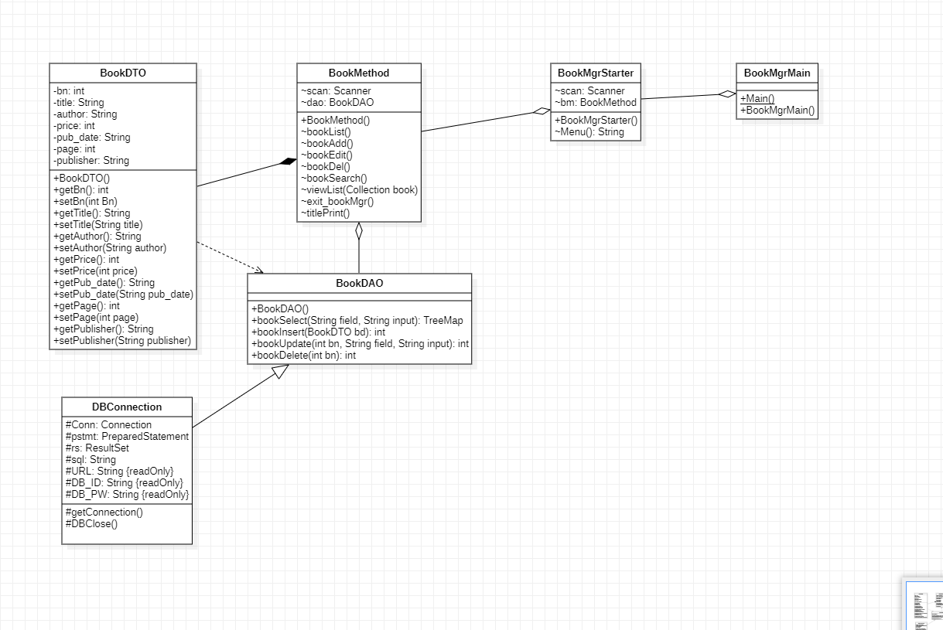
Class Diagram

Slide 4
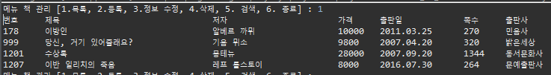
Run book mgr - list

Slide 5
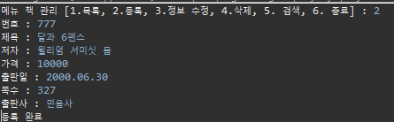
Run book mgr - Register

Slide 6

Run book mgr - Edit

Slide 7
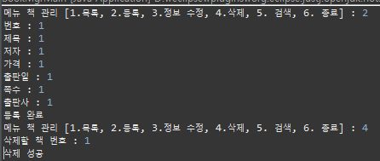
Run book mgr - Delete

Slide 8

Run book mgr - Search

